Slide 1
Chapter 4-1
Processor Design
Notes:
重点

Slide 2





我画的实现了全部指令的数据通路
PC
Add
Add
4
clk
[11:7}
Write data
addr
[19:15}
rd
Instr
Reg
ROM
rs1
ALU
Slice
[24:20}
rs2
0
data1
data2
Res
Address
Mem
Read
clk
ALUop
[31:7}
Slice
Imm
Gen
W data
[31:0}
Branch
Auipc
RegWrite
BranchN
MemtoReg
Imm
ALUsrcB
MemRW
Jump
SCPU_crtl
Notes:
Load和store才会碰memory
RISCV 所有的写地址都是rd

Slide 3
1 Introduction

Slide 4
CPU performance factors
Instruction count
由编译器决定
CPI and Cycle time
由CPU决定
取指IF：Fetch the instruction from the memory
译码阶段ID： Decode and read the registers 同时进行
执行阶段EX：Use ALU to calculate
Arithmetic result
Memory address for load/store内存地址
Branch comparison
访问和阶段MEM：Access data memory for load/store
写回阶段WB:PC ← target address or PC + 4（PC加4移动到吓一跳指令）

Slide 5
2 Logic Design Conventions

Slide 6
Memory
Instruction memory : ROM, input address, get instruction
Data memory: RAM.
Can read or write controlled by signal MemRead and MemWrite.
Read: input address, get instruction if MemRead=1
Write: input address & datain, write into memory if MemWrite =1
MemWrite
Instruction
Address
Address
Read
data
Instruction
Write
data
Instruction
memory
Data
memory
MemRead

Slide 7
Register File
Reg. address
Output from the register
Data output
5 bits
64 bits
5 bits
5 bits
64 bits
64 bits
Reg. address

Slide 8
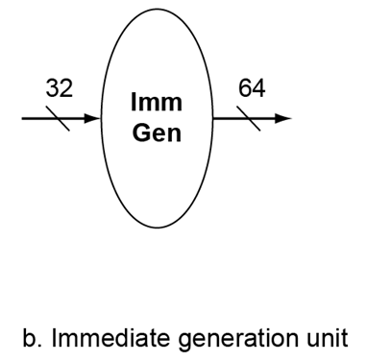
The other elements
Immediate generation unit：
输入指令产生立即数的逻辑功能
根据指令类型（加载，存储或者分支指令），产生相应的立即数
转移指令偏移量左移位的功能
立即数字段符号扩展为64位结果输出
Immediate generation
Load:
0000011
Save:
0100011
Branch:
1100011
Jal:
1101111
L_imm = {{52{inst[31]}}, Inst[31:20]};
S_imm = {{52{inst[31]}}, Inst[31:25], inst[11:7]};
SB_imm = {{51{inst [31]}}, inst[31], inst [7], inst[30:25], inst[11:8],1'b0};
UJ = {{43{inst[31]}}, inst [31], inst[19:12], inst[20], inst[30:21],1'b0};
书上说，高两位不一样就不一样。但是我们要求多实现一个jal，所以前两位还不能判断

Slide 9
3 Building a datapath

Slide 10
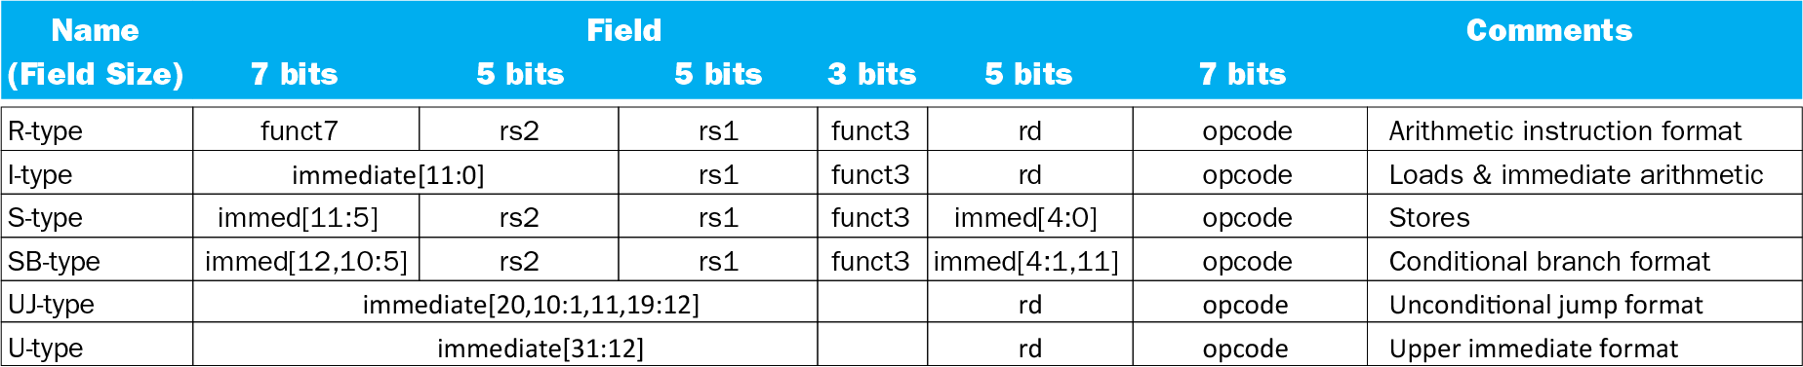
RISC-V fields (format)
opcode：basic operation of the instruction.
rs1： the first register source operand.
rs2： the second register source operand.
rd： the register destination operand.
funct： 函数，该字段选择op字段中操作的具体变体
Immediate: address or immediate

Slide 11
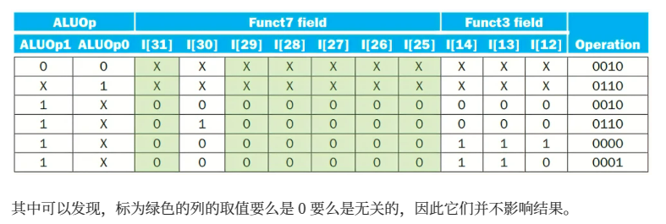
Func7 只有一位有用

Slide 12
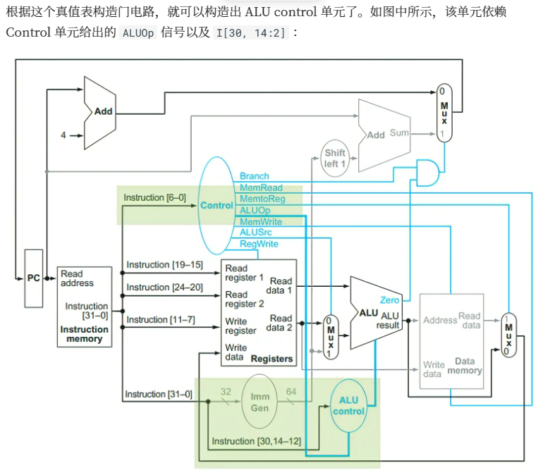

Slide 13
RISC-V assembly language
Category | Instruction | Example | Meaning | Comments
Arithmetic | add | add x5,x6,x7 | x5=x6 + x7 | Add two source register operands
 | subtract | sub x5,x6,x7 | x5=x6 - x7 | First source register subtracts second one
 | add immediate | addi x5,x6,20 | x5=x6+20 | Used to add constants
Data transfer | load doubleword | ld x5, 40(x6) | x5=Memory[x6+40] | doubleword from memory to register
 | store doubleword | sd x5, 40(x6) | Memory[x6+40]=x5 | doubleword from register to memory
Logical | and | and x5, x6, 3 | x5=x6 & 3 | Arithmetic shift right by register
 | inclusive or | or x5,x6,x7 | x5=x6 | x7 | Bit-by-bit OR
Conditional Branch | branch if equal | beq x5, x6, 100 | if(x5 == x6) go to PC+100 | PC-relative branch if registers equal
 | branch if not equal | bne x5, x6, 100 | if(x5 != x6) go to PC+100 | PC-relative branch if registers not equal
Unconditional Branch | jump and link | jal x1, 100 | x1 = PC + 4; go to PC+100 | PC-relative procedure call
 | jump and link register | jalr x1, 100(x5) | x1 = PC + 4; go to x5+100 | procedure return; indirect call

Slide 14
Signals for datapath Defined 7 control signals
Signal name | Effect when deasserted(=0) | Effect when asserted(=1)
RegWrite | None | Register destination input is written with the value on the Write data input
ALUScr | The second ALU operand come from the second register file output (Read data 2) | The second ALU operand is the sign-extended lower 16 bits of the instruction..
Branch （PCSrc） | The PC is replaced by the output of the adder that computers the value PC+4 | The PC is replaced by the output of the adder that computers the branch target.
Jump | The PC is replaced by PC+4 or branch target | The PC is updated by jump address computed by adder
MemRead | None | Data memory contents designated by the address input are put on the Read data output.
MemWrite | None | Data memory contents designated by the address input are replaced by value on the Write data input.
MemtoReg (2位) | 00：The value fed to register Write data input comes from the Alu | 01：The value fed to the register Write data input comes from the data memory.
 |  | 10：The value fed to the register Write data input comes from PC+4

Slide 15
我画的实现了全部指令的数据通路
PC
Add
Add
4
clk
Read address
Inst[11:7}
Write dara
Write register
Reg
File
Instr
Inst[19:15}
Read rigister1
Instruction Memory
Inst[24:20}
ALU
Slice
Read rigister2
0
Read data1
Res
Read data2
Address
Data
Mem
clk
ALUop
Read data
Inst[31:7}
Imm
Gen
Slice
Write data
Inst[31:0}
Branch
Auipc
RegWrite
BranchN
ImmSel
ALUsrcB
Jump
MemtoReg
MemRW
SCPU_crtl
Notes:
Load和store才会碰memory
RISCV 所有的写地址都是rd

Slide 16
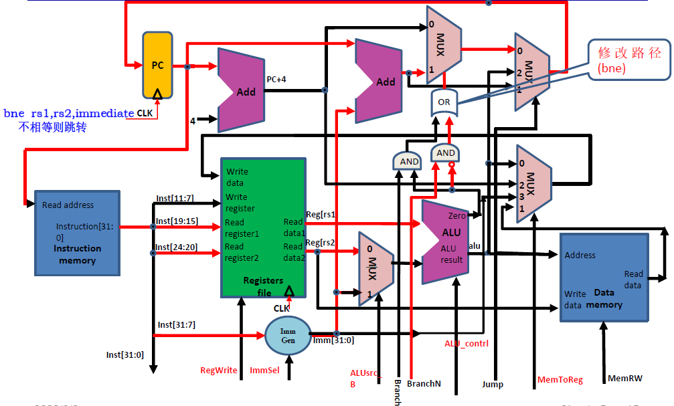
马德实验ppt的扩展指令后的数据通路

Slide 17
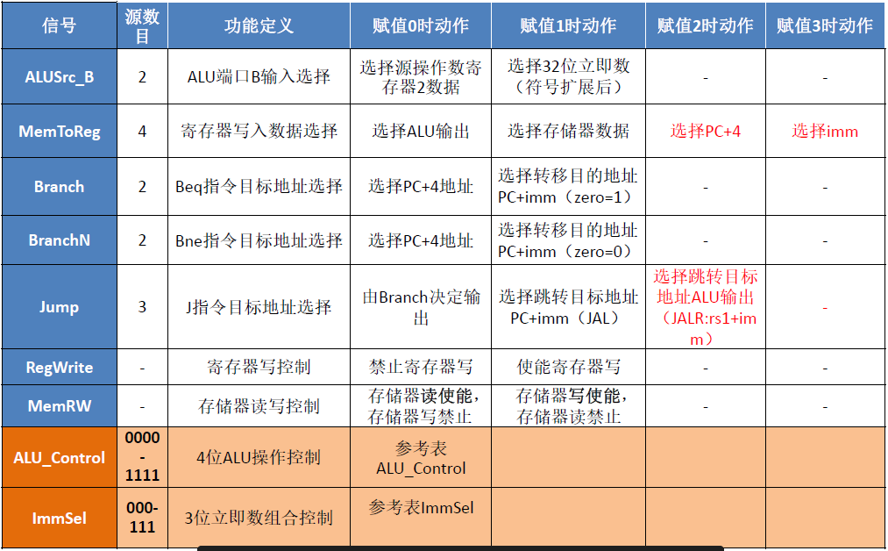
马德实验ppt的控制信号

Slide 18
Performance in Single Cycle Implementation
Let’s see the following table:
Instr | Instr fetch | Register read | ALU op | Memory access | Register write | Total time
ld | 200ps | 100 ps | 200ps | 200ps | 100 ps | 800ps
sd | 200ps | 100 ps | 200ps | 200ps |  | 700ps
R-format | 200ps | 100 ps | 200ps |  | 100 ps | 600ps
beq | 200ps | 100 ps | 200ps |  |  | 500ps
The conclusion:
Different instructions needs different time.
The clock cycle must meet the need of the slowest instruction. So, some time will be wasted.

Slide 19
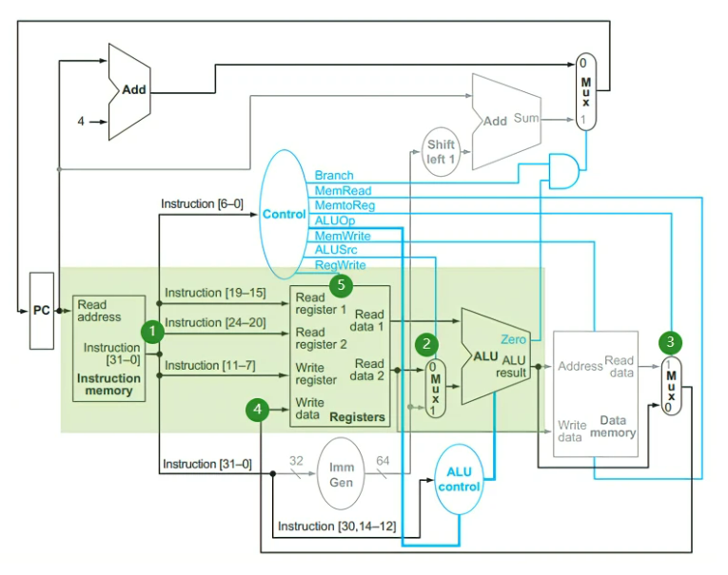
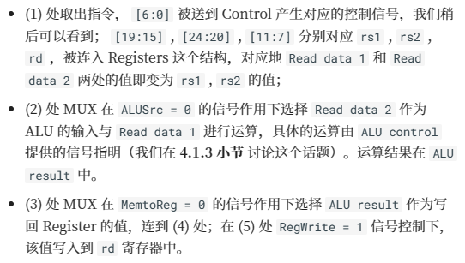
R型指令

Slide 20
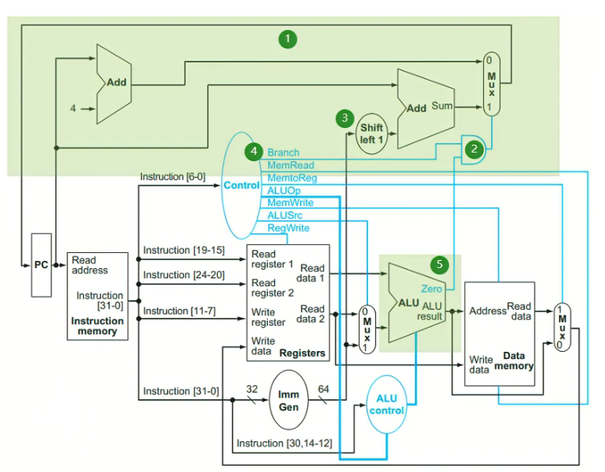
B型指令
Beq：当branch等于1，并且ALU的运算结果是0的时候才跳
Imm Gen 模块，将指令中的立即数符号扩展到 64 位；然后在 (3) 处左移 1 位，所以我们没有保存偏移的最低一位；
但是，我们是选择了直接生成，而非移动。而且是32位。再与 PC 相加

Slide 21
Performance Issues
单周期的实现是指，一个指令的所有工作都在一个时钟周期内完成，也就是 CPI = 1。那么，一个时钟周期的长度就要足够最长的那个指令完成运行。但是，例如 load 类的指令要经过 inst mem, reg file, ALU, data mem, reg file 这么多的步骤，这会使得时钟周期变得很长，导致整体性能变得很差。单周期的实现违反了 common case fast 这一设计原则
因此我们需要引入流水线

Slide 22
4 Interruption & Exception

Slide 23
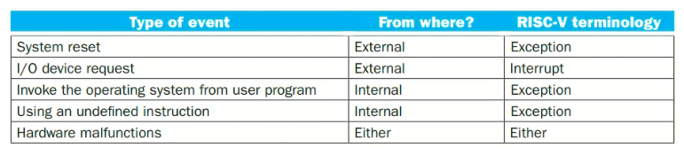
Exception 异常
Arises within the CPU when execute
instruction
e.g., overflow, undefined opcode, syscall, …
Interrupt 中断
From an external I/O controller

Slide 24
中断异常处理
保存地址
mechain Exception Program Counter (mepc机器模式的epc，管理员模式对应sepc)， 中断保存当前pc，异常保存pc+4
保存中断原因
mechain Exception Cause Register (mcause)
处理
跳转到 stvec
恢复
mret指令回到mepc

Slide 25
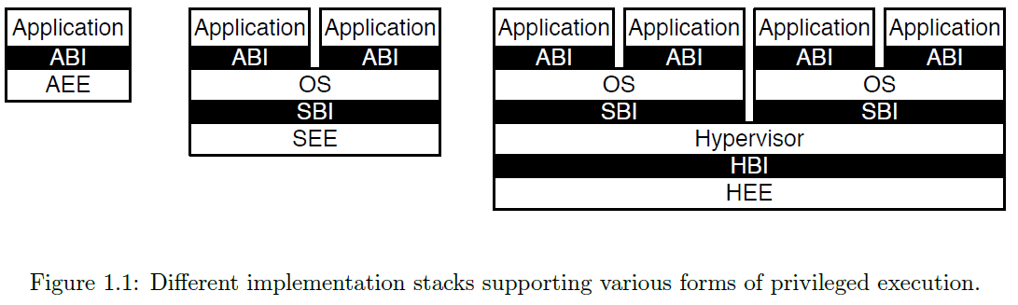
Privileged Architecture
Software stack
直接到底层
虚拟机
通过OS访问
更安全的嵌入式系统
ABI为接口

Slide 26
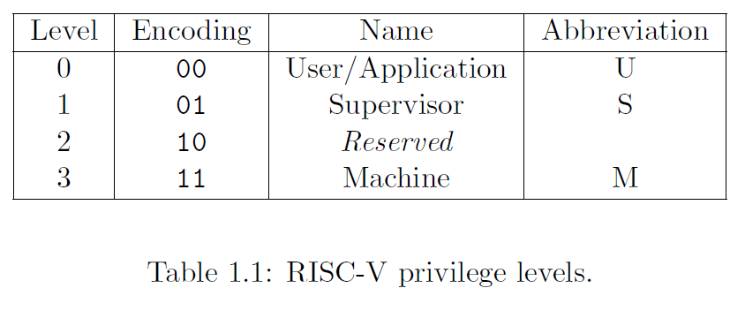
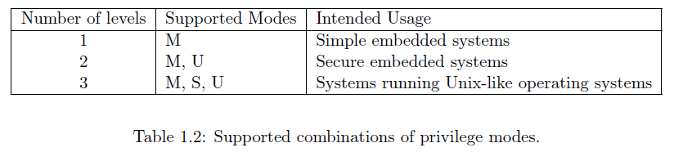
Privileged level
Hypervisor
H
4个mode
Notes:
广义CPU包括内存管理MMU，浮点数管理etc

Slide 27
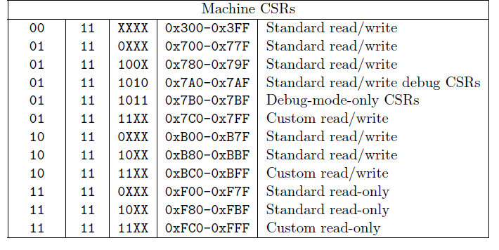
CSR 特权寄存器
CSR[11..0] 4096个
12 bit encoding space
The lowest privileged level that can access CSR
11: read only
00/01/10: read/write
RISC-V中的32个寄存器都是user mode； 处理异常的寄存器是这32个之外的更高级的寄存器
CSR只能读写
Notes:
S

Slide 28
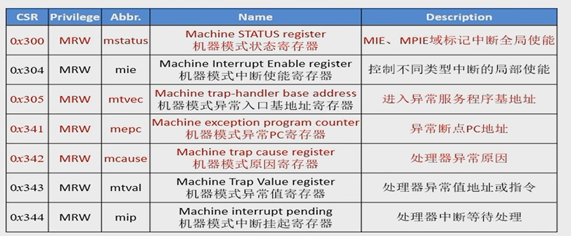
8 important CSR for exception handling
细分中断
Mtvec中的程赋给PC，进入异常模式
引起异常或者该指令的下一条，用于处理完后返回
先处理级别高的异常，等级低的先等待

Slide 29
How Control Checks for Exceptions (Hardware)测试中断的逻辑
Add test logic测试异常的逻辑（所有的情况或一下）
illegal instruction, load address misaligned, store address misaligned ，overflow…
add control signal 控制信号
CauseWrite for mcause
EPCWrite for mepc
TVALWrite for mtval
process of control 数据通路要求修改的地方
mepc ← PC( exception) or PC + 4 (interruption)
mcause ← set correspondent bit
mtval ← memory address or illegal instruction
mstatus.mpie ←Mstatus.mie; mstatus.mie ←0; mstatus.mpp←mp; mp←11
PC←address of process routine ( mtvec, ex. c0000000 )
Notes:
把这些异常都或起来

Slide 30
jump when
mstatus.MIE = 1 && mie[i] = 1 && mip [i]= 1
mret
PC ← CSRs[mepc]
mstatus.MIE ←mstatus.MPIE
mp← mstatus.MPP

